Slide 1

ADTs, BSTs
Lecture 16 (Data Structures 2)
CS61B, Spring 2024 @ UC Berkeley
Slides credit: Josh Hug
Notes:
Probably photoshopped binary tree: http://cs.au.dk/~danvy/binaries.html

Slide 2
Abstract Data Types
Abstract Data Types
Binary Search Trees
Derivation
Definition
contains
Insert
Hibbard deletion
Sets and Maps (are the same thing)
BST Implementation Tips
Lecture 16, CS61B, Spring 2024

Slide 3
Interfaces vs. Implementation
In class:
Developed ALists and SLLists.
Created an interface List61B.
Modified AList and SLList to implement List61B.
List61B provided default methods.
In projects:
Developed ArrayDeque and LinkedListDeque.
Each class implemented the Deque interface.
List61B
AList
SLList
Deque
Array
Deque
LinkedList
Deque

Slide 4
Interfaces vs. Implementation
With DisjointSets, we saw a much richer set of possible implementations.
DisjointSets
ListOfSetsDS
QuickFindDS
QuickUnionDS
WeightedQuickUnionDS

Slide 5

Abstract Data Types
An Abstract Data Type (ADT) is defined only by its operations, not by its implementation.
Deque ADT:
addFirst(Item x);
addLast(Item x);
boolean isEmpty();
int size();
printDeque();
Item removeFirst();
Item removeLast();
Item get(int index);
Deque
Array
Deque
LinkedList
Deque
ArrayDeque and LinkedList Deque are implementations of the Deque ADT.

Slide 6
Another example of an ADT: The Stack
Recall, the Stack ADT supports the following operations:
push(int x): Puts x on top of the stack.
int pop(): Removes and returns the top item from the stack.
insertBack()
push(int x)
getBack()
2
deleteBack()
get(int i)
6
pop()
4

Slide 7
The Stack ADT: yellkey.com/likely
Recall, the Stack ADT supports the following operations:
push(int x): Puts x on top of the stack.
int pop(): Removes and returns the top item from the stack.
Which implementation do you think would result in faster overall performance?
Linked List
Array
insertBack()
push(int x)
getBack()
deleteBack()
get(int i)
pop()
4
Notes:
https://docs.google.com/forms/d/e/1FAIpQLSfH-yq4CktrsMWVS0m31aW1rgiLjIqy4K-UWvkcOfqEtapu_Q/viewform

Slide 8
The Stack ADT
The Stack ADT supports the following operations:
push(int x): Puts x on top of the stack.
int pop(): Removes and returns the top item from the stack
Which implementation do you think would result in faster overall performance?
Linked List
Array
Both are about the same. No resizing for linked lists, so probably a lil faster.
insertBack()
push(int x)
getBack()
deleteBack()
get(int i)
pop()
4

Slide 9
The GrabBag ADT: yellkey.com/involve
The GrabBag ADT supports the following operations:
insert(int x): Inserts x into the grab bag.
int remove(): Removes a random item from the bag.
int sample(): Samples a random item from the bag (without removing!)
int size(): Number of items in the bag.
Which implementation do you think would result in faster overall performance?
Linked List
Array
insertBack()
insert(int x)
getBack()
remove()
deleteBack()
sample()
get(int i)
size(int i)
Notes:
https://docs.google.com/forms/d/e/1FAIpQLSendCcLM69YYICSHT7yMJF1rixUweOTk1g_Z_EicS9HNasIiw/viewform

Slide 10
The GrabBag ADT
The GrabBag ADT supports the following operations:
insert(int x): Inserts x into the grab bag.
int remove(): Removes a random item from the bag.
int sample(): Samples a random item from the bag (without removing!)
int size(): Number of items in the bag.
Which implementation do you think would result in faster overall performance?
Linked List
Array
insertBack()
insert(int x)
getBack()
remove()
deleteBack()
sample()
get(int i)
size(int i)

Slide 11
Abstract Data Types in Java
One thing I particularly like about Java is the syntax differentiation between abstract data types and implementations.
Note: Interfaces in Java aren’t purely abstract as they can contain some implementation details, e.g. default methods.
Example: List<Integer> L = new ArrayList<>();
List
Linked
List
ArrayList

Slide 12
Collections
Among the most important interfaces in the java.util library are those that extend the Collection interface (btw interfaces can extend other interfaces).
Lists of things.
Sets of things.
Mappings between items, e.g. jhug’s grade is 88.4, or Creature c’s north neighbor is a Plip.
Maps also known as associative arrays, associative lists (in Lisp), symbol tables, dictionaries (in Python).
Collection
List
Set
Map
Notes:
Note: In SP24, we discovered that Maps might not actually extend the Collection interface. (See https://docs.oracle.com/javase/8/docs/api/java/util/Collection.html)

Slide 13
Map Example
Maps are very handy tools for all sorts of tasks. Example: Counting words.
Map<String, Integer> m = new TreeMap<>();
String[] text = {"sumomo", "mo", "momo", "mo",
"momo", "no", "uchi"};
for (String s : text) {
int currentCount = m.getOrDefault(s, 0);
m.put(s, currentCount + 1);
}
sumomo | 1
mo | 2
momo | 2
no | 1
uchi | 1
m = {}
text = ["sumomo", "mo", "momo", "mo", \
"momo", "no", "uchi"]
for s in text:
current_count = m.get(s, 0)
m[s] = current_count + 1
Python equivalent

Slide 14
Java Libraries
The built-in java.util package provides a number of useful:
Interfaces: ADTs (lists, sets, maps, priority queues, etc.) and other stuff.
Implementations: Concrete classes you can use.
Today, we’ll learn the basic ideas behind the TreeSet and TreeMap.
Collection
List
Set
Map
Linked
List
ArrayList
HashSet
TreeSet
HashMap
TreeMap

Slide 15
Binary Search Trees: Derivation
Abstract Data Types
Binary Search Trees
Derivation
Definition
contains
Insert
Hibbard deletion
Sets and Maps (are the same thing)
BST Implementation Tips
Lecture 16, CS61B, Spring 2024

Slide 16
Analysis of an OrderedLinkedListSet<Character>
In an earlier lecture, we implemented a set based on unordered arrays. For the order linked list set implementation below, name an operation that takes worst case linear time, i.e. Θ(N).
A
B
C
D
E
F
G
7
sent
size
size
contains
add
iterator
Notes:
8:19 begin

Slide 17
Analysis of an OrderedLinkedListSet<Character>
In an earlier lecture, we implemented a set based on unordered arrays. For the order linked list set implementation below, name an operation that takes worst case linear time, i.e. Θ(N).
A
B
C
D
E
F
G
7
sent
size
size
contains
add
iterator
Notes:
8:19 begin

Slide 18
Optimization: Extra Links
Fundamental Problem: Slow search, even though it’s in order.
Add (random) express lanes. Skip List (won’t discuss in 61B)
A
B
C
D
E
F
G

Slide 19
Optimization: Change the Entry Point
Fundamental Problem: Slow search, even though it’s in order.
Move pointer to middle.
A
B
C
D
E
F
G

Slide 20
Optimization: Change the Entry Point, Flip Links
Fundamental Problem: Slow search, even though it’s in order.
Move pointer to middle and flip left links. Halved search time!
A
B
C
D
E
F
G

Slide 21
Optimization: Change the Entry Point, Flip Links
Fundamental Problem: Slow search, even though it’s in order.
How do we do even better?
Dream big!
A
B
C
D
E
F
G

Slide 22
Optimization: Change Entry Point, Flip Links, Allow Big Jumps
Fundamental Problem: Slow search, even though it’s in order.
How do we do better?
A
B
C
D
E
F
G
D
B
F
A
C
E
G
Notes:
3 minutes from start of this section

Slide 23
Binary Search Trees: Definition
Abstract Data Types
Binary Search Trees
Derivation
Definition
contains
Insert
Hibbard deletion
Sets and Maps (are the same thing)
BST Implementation Tips
Lecture 16, CS61B, Spring 2024

Slide 24
Tree
A tree consists of:
A set of nodes.
A set of edges that connect those nodes.
Constraint: There is exactly one path between any two nodes.
Green structures below are trees. Pink ones are not.

Slide 25
Rooted Trees and Rooted Binary Trees
In a rooted tree, we call one node the root.
Every node N except the root has exactly one parent, defined as the first node on the path from N to the root.
Unlike (most) real trees, the root is usually depicted at the top of the tree.
A node with no child is called a leaf.
In a rooted binary tree, every node has either 0, 1, or 2 children (subtrees).
A
A
A
For each of these:
A is the root.
B is a child of A. (and C of B)
A is a parent of B. (and B of C)
B
B
B
C
C
C
C
Not binary!

Slide 26
Binary Search Trees
A binary search tree is a rooted binary tree with the BST property.
BST Property. For every node X in the tree:
Every key in the left subtree is less than X’s key.
Every key in the right subtree is greater than X’s key.
dog
debt
bag
flat
bus
ears
alf
cat
elf
glut
axe
cow
fish
gut
Binary Search Tree
Binary Tree, but not a Binary Search Tree

Slide 27
Binary Search Trees
Ordering must be complete, transitive, and antisymmetric. Given keys p and q:
Exactly one of p ≺ q and q ≺ p are true.
p ≺ q and q ≺ r imply p ≺ r.
One consequence of these rules: No duplicate keys allowed!
Keeps things simple. Most real world implementations follow this rule.
dog
debt
bag
flat
bus
ears
alf
cat
elf
glut
axe
cow
fish
gut
Binary Search Tree
Binary Tree, but not a Binary Search Tree

Slide 28
contains
Abstract Data Types
Binary Search Trees
Derivation
Definition
contains
Insert
Hibbard deletion
Sets and Maps (are the same thing)
BST Implementation Tips
Lecture 16, CS61B, Spring 2024

Slide 29
Finding a searchKey in a BST (come back to this for the BST lab)
If searchKey equals T.key, return.
If searchKey ≺ T.key, search T.left.
If searchKey ≻ T.key, search T.right.
dog
bag
flat
alf
cat
elf
glut

Slide 30
Finding a searchKey in a BST
If searchKey equals T.key, return.
If searchKey ≺ T.key, search T.left.
If searchKey ≻ T.key, search T.right.
dog
bag
flat
static BST find(BST T, Key sk) {
if (T == null)
return null;
if (sk.equals(T.key))
return T;
else if (sk ≺ T.key)
return find(T.left, sk);
else
return find(T.right, sk);
}
alf
cat
elf
glut

Slide 31
BST Search: http://yellkey.com/leave
What is the runtime to complete a search on a “bushy” BST in the worst case, where N is the number of nodes.
Θ(log N)
Θ(N)
Θ(N log N)
Θ(N²)
Θ(2^{N})
“bushiness” is an intuitive concept that we haven’t defined.
Notes:
https://docs.google.com/forms/d/e/1FAIpQLSeL9QGBEbgxJCHJbSYAfryceABZ4i0vR-Vp8XrZ_ddeVHdkNw/viewform

Slide 32
BST Search
What is the runtime to complete a search on a “bushy” BST in the worst case, where N is the number of nodes.
Θ(log N)
Height of the tree is ~log₂(N)

Slide 33
BSTs
Bushy BSTs are extremely fast.
At 1 microsecond per operation, can find something from a tree of size 10³⁰⁰⁰⁰⁰ in one second.
Much (perhaps most?) computation is dedicated towards finding things in response to queries.
It’s a good thing that we can do such queries almost for free.

Slide 34
insert
Abstract Data Types
Binary Search Trees
Derivation
Definition
contains
insert
Hibbard deletion
Sets and Maps (are the same thing)
BST Implementation Tips
Lecture 16, CS61B, Spring 2024

Slide 35
Inserting a New Key into a BST
Search for key.
If found, do nothing.
If not found:
Create new node.
Set appropriate link.
Example:
insert “eyes”
dog
bag
flat
alf
cat
elf
glut

Slide 36
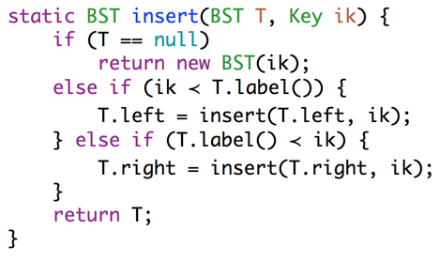
Inserting a New Key into a BST
Search for key.
If found, do nothing.
If not found:
Create new node.
Set appropriate link.
dog
bag
flat
alf
cat
elf
glut
static BST insert(BST T, Key ik) {
if (T == null)
return new BST(ik);
if (ik ≺ T.key)
T.left = insert(T.left, ik);
else if (ik ≻ T.key)
T.right = insert(T.right, ik);
return T;
}
eyes
Arms length recursion: A common rookie bad habit to avoid:
if (T.left == null)
T.left = new BST(ik);
else if (T.right == null)
T.right = new BST(ik);

Slide 37
Avoid Arms-Length Recursion
if (T.left.left == null)
T.left.left = new BST(ik);
else if (T.left.right == null)
T.left.right = new BST(ik);
else if (T.right.left == null)
T.right.left = new BST(ik);
else if (T.right.right == null)
T.right.right = new BST(ik);
This base case is too complicated. The recursion can take us further.
if (T.left == null)
T.left = new BST(ik);
else if (T.right == null)
T.right = new BST(ik);
if (T == null)
return new BST(ik);
Better, but still not the best base case. Avoid arms-length recursion!
The best base case.

Slide 38
Hibbard deletion
Abstract Data Types
Binary Search Trees
Derivation
Definition
contains
Insert
Hibbard deletion
Sets and Maps (are the same thing)
BST Implementation Tips
Lecture 16, CS61B, Spring 2024

Slide 39
Deleting from a BST
3 Cases:
Deletion key has no children.
Deletion key has one child.
Deletion key has two children.
dog
bag
flat
alf
cat
elf
glut
eyes

Slide 40
Case 1: Deleting from a BST: Key with no Children
Deletion key has no children (“glut”):
Just sever the parent’s link.
What happens to “glut” node?
dog
bag
flat
alf
cat
elf
glut
eyes

Slide 41
Case 1: Deleting from a BST: Key with no Children
Deletion key has no children (“glut”):
Just sever the parent’s link.
What happens to “glut” node?
Garbage collected.
dog
bag
flat
alf
cat
elf
glut
eyes

Slide 42
Case 2: Deleting from a BST: Key with one Child
Example: delete(“flat”):
Goal:
Maintain BST property.
Flat’s child definitely larger than dog.
Safe to just move that child into flat’s spot.
Thus: Move flat’s parent’s pointer to flat’s child.
dog
bag
flat
alf
cat
elf
eyes

Slide 43
Case 2: Deleting from a BST: Key with one Child
Example: delete(“flat”):
Goal:
Maintain BST property.
Flat’s child definitely larger than dog.
Safe to just move that child into flat’s spot.
Thus: Move flat’s parent’s pointer to flat’s child.
Flat will be garbage collected (along with its instance variables).
dog
bag
flat
alf
cat
elf
eyes

Slide 44
Hard Challenge
Delete k.
k
e
v
b
g
p
y
a
d
f
m
r
x
z

Slide 45
Case 3: Deleting from a BST: Deletion with two Children (Hibbard)
Example: delete(“dog”)
Goal:
Find a new root node.
Must be > than everything in left subtree.
Must be < than everything right subtree.
Would bag work?
dog
bag
flat
alf
cat
elf
glut
eyes

Slide 46
Case 3: Deleting from a BST: Deletion with two Children (Hibbard)
Example: delete(“dog”)
Goal:
Find a new root node.
Must be > than everything in left subtree.
Must be < than everything right subtree.
Choose either predecessor (“cat”) or successor (“elf”).
Delete “cat” or “elf”, and stick new copy in the root position:
This deletion guaranteed to be either case 1 or 2. Why?
This strategy is sometimes known as “Hibbard deletion”.
dog
bag
flat
alf
cat
elf
glut
eyes

Slide 47
Hard Challenge (Hopefully Now Easy)
Delete k.
k
e
v
b
g
p
y
a
d
f
m
r
x
z

Slide 48
Hard Challenge (Hopefully Now Easy)
Delete k. Two solutions: Either promote g or m to be in the root.
Below, solution for g is shown.
k
e
v
b
g
p
y
a
d
f
m
r
x
z

Slide 49
Hard Challenge (Hopefully Now Easy)
Two solutions: Either promote g or m to be in the root.
Below, solution for g is shown.
g
e
v
b
f
p
y
a
d
m
r
x
z

Slide 50
Sets and Maps (are the same thing)
Abstract Data Types
Binary Search Trees
Derivation
Definition
contains
Insert
Hibbard deletion
Sets and Maps (are the same thing)
BST Implementation Tips
Lecture 16, CS61B, Spring 2024

Slide 51
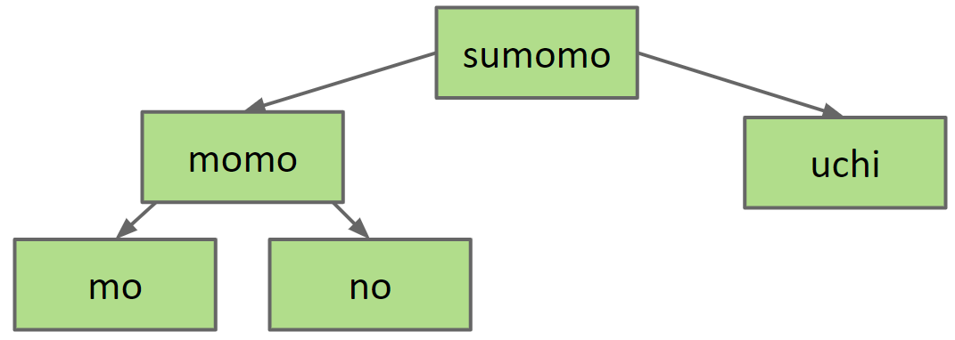
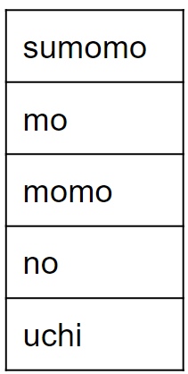
Sets vs. Maps
Can think of the BST below as representing a Set:
{mo, no, sumomo, uchi, momo}
sumomo
mo
momo
no
uchi
sumomo
momo
uchi
mo
no

Slide 52
Sets vs. Maps
Can think of the BST below as representing a Set:
{mo, no, sumomo, uchi, momo}
But what if we wanted to represent a mapping of word counts?
sumomo
mo
momo
no
uchi
sumomo
momo
uchi
mo
no
sumomo | 1
mo | 2
momo | 2
no | 1
uchi | 1
????

Slide 53
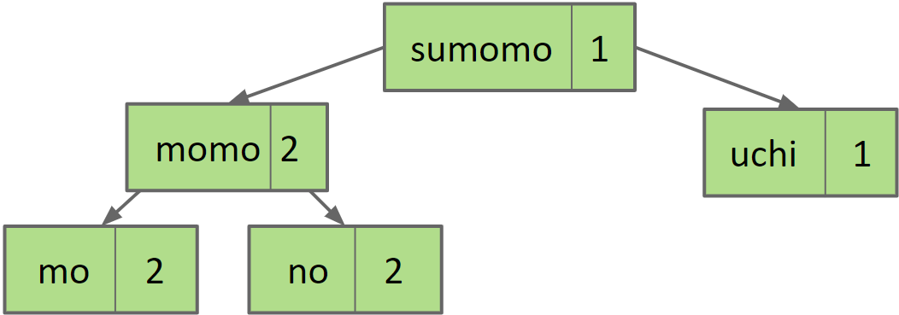
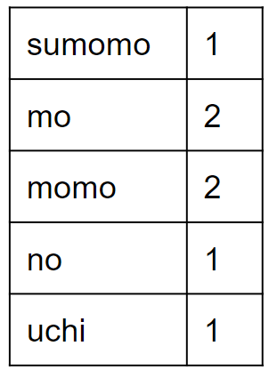
Sets vs. Maps
To represent maps, just have each BST node store key/value pairs.
Note: No efficient way to look up by value.
Example: Cannot find all the keys with value = 1 without iterating over ALL nodes. This is fine.
sumomo | 1
mo | 2
momo | 2
no | 1
uchi | 1
sumomo 1
momo 2
uchi 1
mo 2
no 1

Slide 54
Summary
Abstract data types (ADTs) are defined in terms of operations, not implementation.
Several useful ADTs: Disjoint Sets, Map, Set, List.
Java provides Map, Set, List interfaces, along with several implementations.
We’ve seen two ways to implement a Set (or Map): ArraySet and using a BST.
ArraySet: Θ(N) operations in the worst case.
BST: Θ(log N) operations in the worst case if tree is balanced.
BST Implementations:
Search and insert are straightforward (but insert is a little tricky).
Deletion is more challenging. Typical approach is “Hibbard deletion”.

Slide 55
BST Implementation Tips
Abstract Data Types
Binary Search Trees
Derivation
Definition
contains
Insert
Hibbard deletion
Sets and Maps (are the same thing)
BST Implementation Tips
Lecture 16, CS61B, Spring 2024

Slide 56
Tips for BST Lab
Code from class was “naked recursion”. Your BSTMap will not be.
For each public method, e.g. put(K key, V value), create a private recursive method, e.g. put(K key, V value, Node n)
When inserting, always set left/right pointers, even if nothing is actually changing.
Avoid “arms length base cases”. Don’t check if left or right is null!
static BST insert(BST T, Key ik) {
if (T == null)
return new BST(ik);
if (ik ≺ T.label()))
T.left = insert(T.left, ik);
else if (ik ≻ T.label())
T.right = insert(T.right, ik);
return T;
}
Avoid “arms length base cases”.
if (T.left == null)
T.left = new BST(ik);
else if (T.right == null)
T.right = new BST(ik);
Always set, even if nothing changes!

